Slide 1
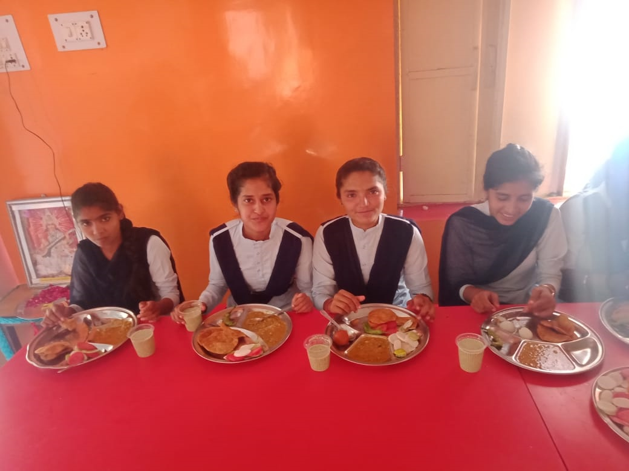
MID DAY MEAL SCHEME GOVT.OF HARYANA
ANNUAL WORK PLAN & BUDGET 2020-21

Slide 2
STRUCTURE OF PPT
Section I- Background
Section II- Count of Children & Institutions
Section III- Allocation & Utilization of funds
Section IV- Achievements
Section V- Review of assurance given in PAB 2019-20
Section VI- Monitoring Report
Section- VII- Joint Review Mission
Section- VIII-Proposal of funds for the year 2020-21

Slide 3
BRIEF NOTE - MID DAY MEAL SCHEME
Dry ration was distributed to the children before 2004.
Serving of cooked food was started in all Government schools, Local bodies, Government aided primary schools from 15.08.2004 onwards.
The scheme was further extended to all middle schools during the Academic year 2008-09.
Objectives:
To attract Out-of-School Children (OoSC).
To retain the in-school children and reduce the drop out rate.
To improve the health of students.
Norms:
To provide 450 calories of energy/100 gms. of food grains to primary students.
To provide 700 calories of energy/150 gms. of food grains to upper primary students.
To provide 20 gms/ 30 gms proteins respectively to primary and upper primary students.
Cooking Cost :
Components of cooking cost includes pulses, vegetables, cooking oil and fuel.
Rs. 4.48 for every primary student and Rs. 6.71 for every upper primary student has been provisioned towards cooking cost.

Slide 4
MANAGEMENT STRUCTURE
Principal Secretary School Education
Director Elementary Education
Additional Director Elementary Education &Mid Day Meals
District Elementary Education Officer
Block Elementary Education Officer
School

Slide 5
SECTION –II
COUNT OF CHILDREN
&
INSTITUTIONS

Slide 6
Count of Institutes and Children covered in 2019-20
Types of Schools | Institutes | Children in 2019-20 | Beneficiaries in 2019-20
Primary | 8677 | 883870 | 827306(93.60%)
Upper Primary | 5663 | 561220 | 536561(95.61%)
NCLP (special Training Centers) | 57 | 2934 | 2238(76.28%)
Total | 14397 | 1448024 | 1366105(94.34%)
NCLP (National Child Labour Project) (Special Training Centres) are Govt. of India Schools under Labour Department in two districts Faridabad & Gurugram.

Slide 7
Total No. of Institutions & Enrolment during the Year 2019-20 & 2020-21
Types of Institutions | No of Institutions & Enrolment 2019-20 |  | No of Institutions & Enrolment 2020-21
 | No of institutions | Enrolment | No of institutions | Enrolment
Govt. Primary Schools | 8677 | 883870 | 8677 | 827306
Upper Primary | 5663 | 561220 | 5663 | 536561
NCLP Centres | 57 | 2934 | 57 | 2238
Grand Total | 14397 | 1448024 | 14397 | 1366105

Slide 8
SECTION –III
ALLOCATION & UTILIZATION OF FUNDS/FOODGRAINS

Slide 9
Quantity Of Food Grains-Allocated, Lifted & Utilization for Schools
(Qty in Metric Tonnes)
Foodgrains | Allocation Upto 31-3-2020 | Opening Balance as on 1-4-19 | Lifting (Upto 31-3-2020) | Utilization (Up to 31-3-2020)
Primary | 19771.00 | 795.60 | 18975.40 | 19193.49
Upper Primary | 20452.80 | 949.16 | 18410.40 | 18752.89
Total | 40223.80 | 1744.76 | 37385.80 | 37946.38

Slide 10
Total Budgetary allocation for the year 2019-20
(Rs. in Cr..)
Period | Approved Centre Share | Approved State Share | Total | Expenditure Up to 31-03-2020
Allocation upto 31-3-2020 | 150.00 | 221.15 | 371.15 | 310.83 (99.81%)
Released Upto 31-03-2020 | 108.90 | 202.51 | 311.41(except Unspent)

Slide 11
Budget Allocation & Expenditure on cooking cost upto 31-03-2020
Rs. In Cr.
Class Category | Approved Budget |  |  | Unspent Balance of last year (CS+SS) | Released Amount (CS+SS) | Total (CS+SS) | Expenditure
 | Centre Share | State Share | Total
Primary | 53.18 | 35.39 | 88.57 | 16.44 | 72.13 | 88.57 | 85.99 (97.09%)
U.Pry | 54.94 | 36.54 | 91.48 | 17.64 | 73.85 | 91.49 | 83.53 (91.30%)
Total | 108.12 | 71.93 | 180.05 | 34.08 | 145.98 | 180.06 | 169.52 (94.15%)
*.

Slide 12
Budget Allocation & Expenditure on Cost of Foodgrains upto 31-03-2020
(Rs. In Cr.)
Class Category | Approved Budget (100% Centrally sponsored) | Unspent Balance of last year (CS) | Released Amount (CS) | Total (CS) | Expenditure
Primary | 5.12 | 2.33 | 2.59 | 4.92 | 4.50(91.46%)
U.Pry | 5.10 | 2.30 | 2.56 | 4.86 | 4.43(91.15%)
NCLP | 0.03 | 0.00 | 0.02 | 0.02 | 0.02 (100%)
Total | 10.25 | 4.63 | 5.17 | 9.80 | 8.95(91.33%)

Slide 13
Budget allocation & Expenditure towards Honorarium for Cook cum Helpers
(Rs. In Cr.)
Stage | No. of Cooks Approved by GOI | No. of Cooks actually Working | Approved budget by GOI | Unspent Balance of last year (CS+SS) | Released Amount (CS+SS) | Total (CS+SS) | Expenditure up to 31-03-19
Pry. | 19001 | 18255 | 65.49 | 3.67 | 65.57 | 69.24 | 63.89 (92.27%)
U.Pry | 12039 | 11945 | 42.14 | 2.32 | 40.70 | 43.02 | 41.81 (97.19%)
Total | 31040 | 30200 | 107.63 | 5.99 | 106.27 | 112.26 | 105.70 (94.16%)
Note: The bills of Honorarium for Cook cum Helpers were cleared for the year 2019-2020 .

Slide 14
Budget Allocation & Expenditure on Management Monitoring & Evaluation(MME) upto 31-03-2020
(Rs. In Cr.)
Class Category | Approved Budget (100% Centrally sponsored) | Unspent Balance of last year (CS) | Released Amount (CS) | Total (CS) | Expenditure
Primary | 1.90 | 1.05 | 1.15 | 2.20 | 1.15 (52.27%)
U.Primary | 1.93 | 0.55 | 1.08 | 1.63 | 0.78 (47.85%)
Total | 3.83 | 1.60 | 2.23 | 3.83 | 1.93 (50.39%)

Slide 15
Budget Allocation & Expenditure on Transportation Cost upto 31-03-2020
(Rs.In Cr.)
Class Category | Approved Budget (100% Centrally sponsored) | Unspent Balance of last year (CS) | Released Amount (CS) | Total (CS) | Expenditure
Primary | 3.25 | 0.91 | 1.99 | 2.90 | 1.19 (41.03%)
U.Primary | 2.78 | 0.90 | 1.97 | 2.87 | 1.18 (41.11%)
Total | 6.03 | 1.81 | 3.96 | 5.77 | 2.37 (41.07%)
Note: The bills of Transportation cost were received late . Even bills of year 2019-20 of all districts except Hissar & Fatehabad have not been received till date. Hence, less expenditure incurred.

Slide 16
Recipes
The school children are provided cooked food as per menu decided by the Department. As per the observations of Joint Review Mission, more vegetables and pulses have been included so that children could receive prescribed nutritive value through meal. Therefore, recipes have been reviewed and now 20 recipes (9 wheat based, 6 rice based, 1 peanut based and 4 Bajra based w.e.f 16/11/2018) are being served with w.e.f. 01-04-2014. New recipes are as under:-
Wheat based (9) | Rice Based(6) | Bajra Based(5)
Missi Roti with seasonal vegetable | Vegetable Pulao and Kala Channa Pulaoa | Bajre ke gulgule
Atta ka Halwa with black channa | Postik Khichdi | Bajre ki puri
Roti with Daal ghiya/kaddu | Rajma and Rice | Bajre ki Khichi
Meetha Daliya | KarhiPakora/seasonal Vegetable and Rice | Bajre ke biscuit
Wheat soya puri and vegetable/ white channa Aloo | Sweet Rice | Peanut/ Moongfali chakki
Paushtik Dalia | Coconut Pulaoa
Meetha Pura anh Kheer
Channa Dal Prantha/Vegetable prantha
Chana Dal/Moongdal/Sabut Moong dal and Roti

Slide 17
SECTION –IV
ACHIEVEMENTS

Slide 18
Rashtriya Poshan Maah
Rashtriya Poshan Maah was celebrated in 21 districts of the State from 5 to 28th September. During this week, following activities were covered:
05.09.2019 : In all schools ‘hand washing day’ has been celebrated.
06.09.2019: All schools have celebrated Beti ka Janamdin-School mai Abhinandan.
10.09.2019 & 11.09.2019 : Health check-ups of children with the help of Health Department and also provided health supplements to children.
12.09.2019: Training provided to all cooks for cleanliness, quality of food by Master Trainers at Block Level.
13.09.2019: Recipe competition were organized in all schools of all Districts and Block Level. All students were guided regarding personal hygiene, brushing teeth and washing hands.
17.09.2018: Students were inspired for maintaining kitchen gardens in schools

Slide 19
Continued…..
18.09.2019 & 19.09.2019 : A painting/posture competition on Nutrition was organized at primary and upper primary level and winners were honoured with certificates.
20.09.2019 : A Quiz competition on Nutrition was organized at primary and upper primary level and winners were honoured with certificates.
21.09.2019 : A Debate competition on Nutrition was organized at primary and upper primary level and winners were honoured with certificates
22.09.2019 : An Essay Writing Competition on Nutrition was organized at primary and upper primary level and winners were honoured with certificates.
25.09.2019: Advertisements regarding Rashtriya Poshan Maah was printed in newspapers for sensitizing the students and public.
26.09.2019 & 28.09.2019: All School Head Teachers at District and Block Level were sensitized regarding safe drinking water.

Slide 20
ACHIEVEMENTS
The Maternity leave (without pay) for Six months have been allowed to Female Cook-cum-Helpers working under Mid Day Meal Scheme.
National De-worming day has been celebrated twice in a year on February & August 2019 and Albendazole Tablets were disturbed to the School Children upto the age of 1 to 15 Years two hours before providing the MDM.
The Cook-cum-Helpers have been enrolled under Pradhan Mantri Shram Yogi Maan Dhan Scheme(PM-SYM). Out of a total of 9411 eligible Cook-cum-Helpers ( between the age group 18 to 40 years), 9269 have been enrolled under the Scheme.
The salary of Cook-cum –Helpers has been increased from Rs2500 to Rs3500 w.e.f 1/7/2018.
The Cook-cum –Helpers are being provided two Uniforms every year w.e.f 2018 @ Rs. 300 per uniform.
2554 Kitchen gardens are being maintained in schools under MDM Scheme.

Slide 21
As per directions of Govt. Of India Fortified Atta, in Six Districts Ambala , Sonipat , Panchkula , Karnal , Kurukstera and Kaithal is being used for preparing MDM w.e.f 1st July 2019.
As per directions of Govt. Of India Fortified Oil and Salt is is being used for preparing MDM
The Recipes have been increased From 13 to 20 w.e.f 16/11/2018 under MDM Scheme in Haryana State.
The advertisement regarding Mid Day Meal has been published in “Times of India” , The Tribune, Hindustan Times , Dainik Bhaskar , Dainik Jagaran Newspaper, Indian Express, Dainik Severa, Panjab Kesari & Amar Ujala.
Advertisement for Radio Jingles was given on 91.1 FM and 93.5 Red FM.
Advertisement shows on television channels like Janta TV, News 18 & Haryana News.
Fortified Milk will be provided in all Districts w.e.f 4/5/2019.

Slide 22
One Day workshop on Food Fortification , Safety and Nutrition was also organized on 28/1/2020 for awareness generation in which 119 Master Trainers , District Elementary Education Officers, Programe Executive, Account executive , Data Entery Opertor and Mointoring Officers participated.
The Data entry on MIS Portal has been completed 100% upto March, 2020.
The Data entry on Automated Monitoring System Portal has been completed 90% on 13th March, 2020.

Slide 23
Best Efforts of doing toothbrush after taking meal has been successful in GPS Baddo Patti, In District Hissar w.e.f 20.11.2019

Slide 24
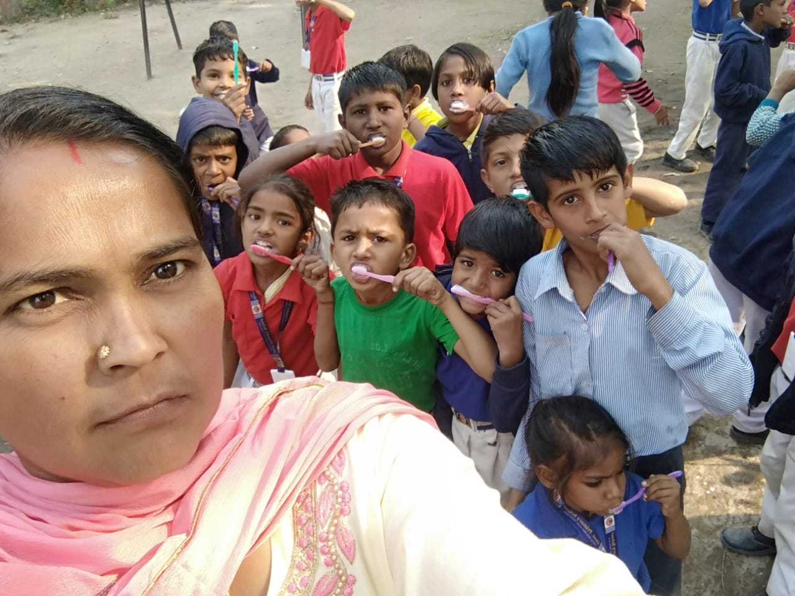
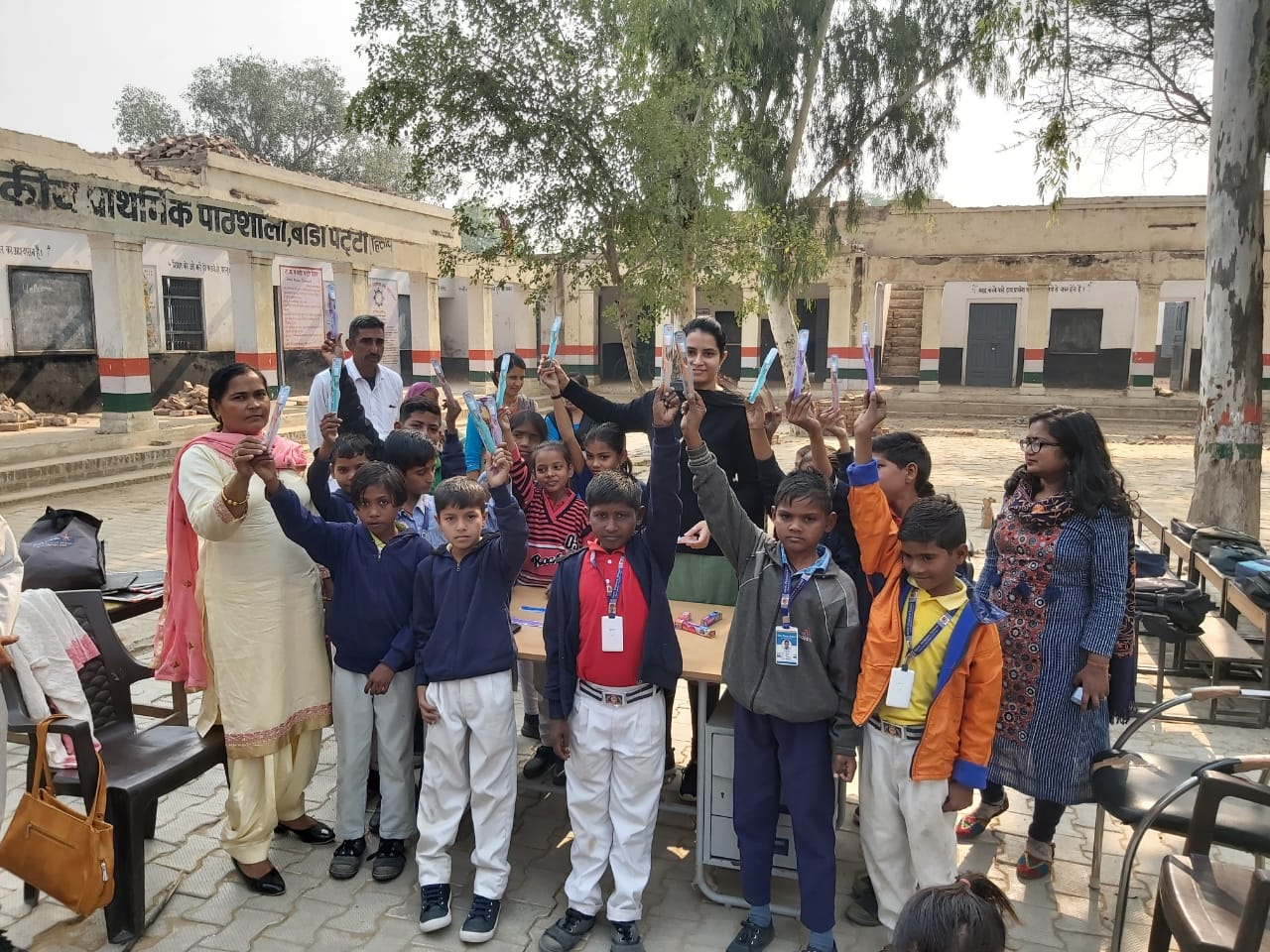
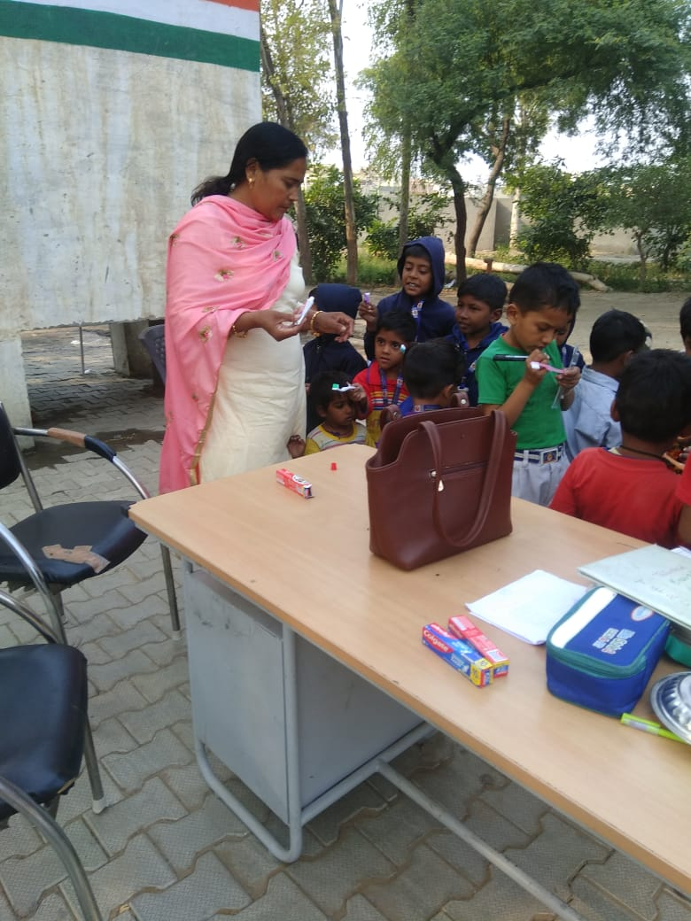
24

Slide 25
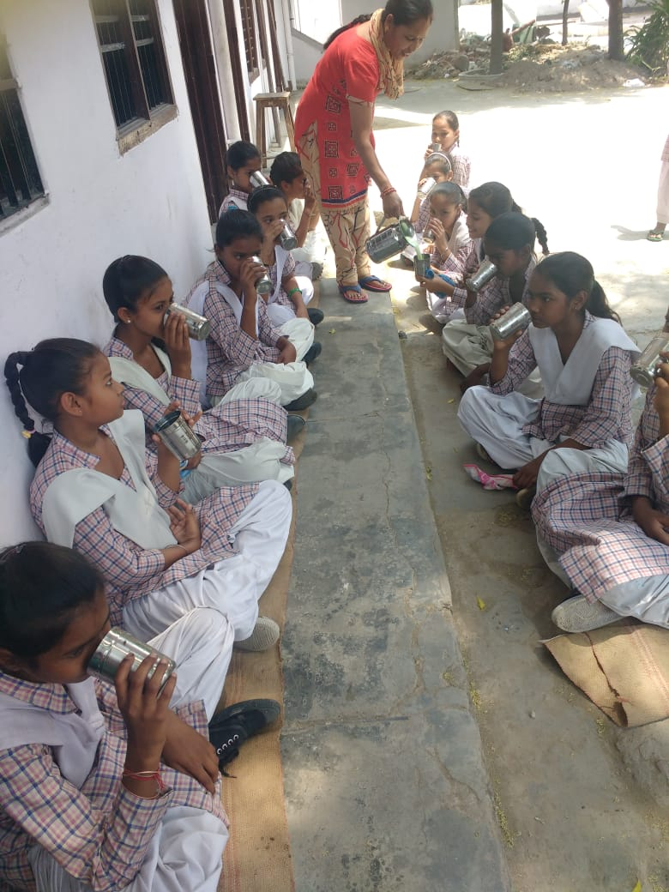
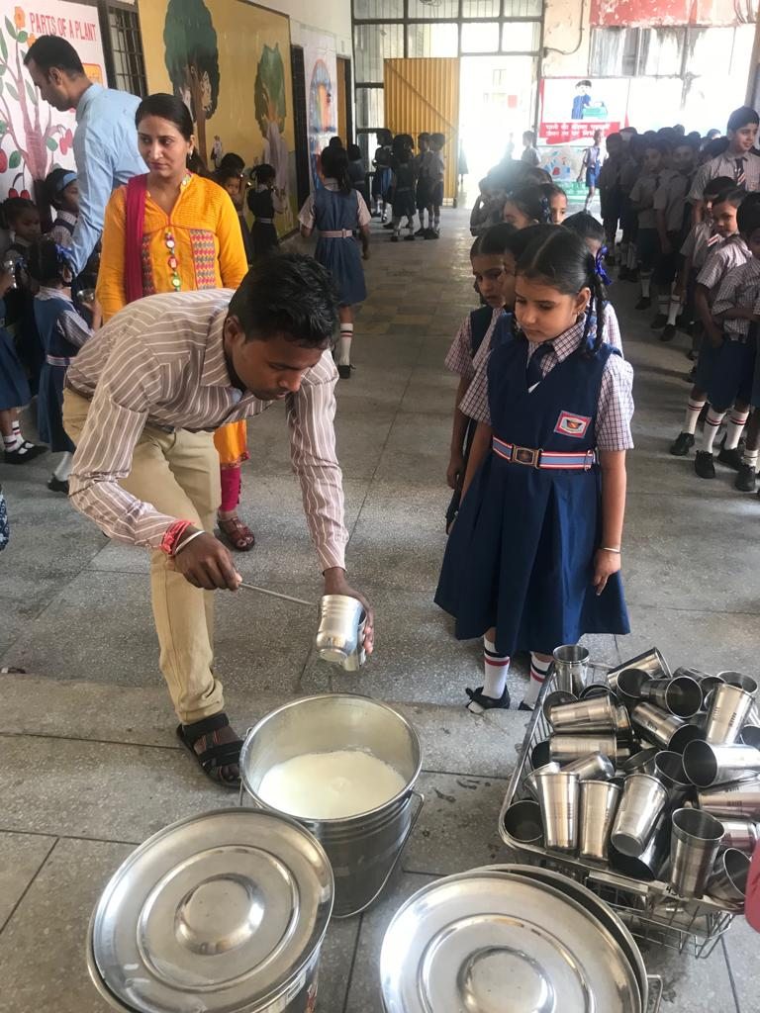
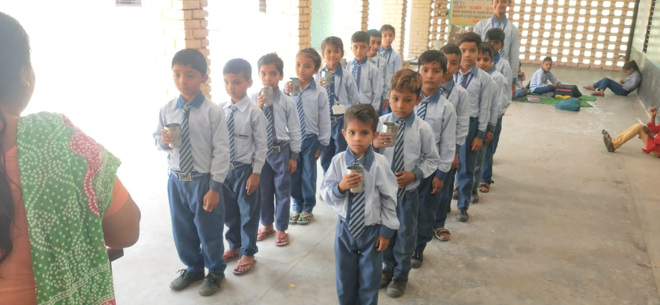
Milk Started

Slide 26
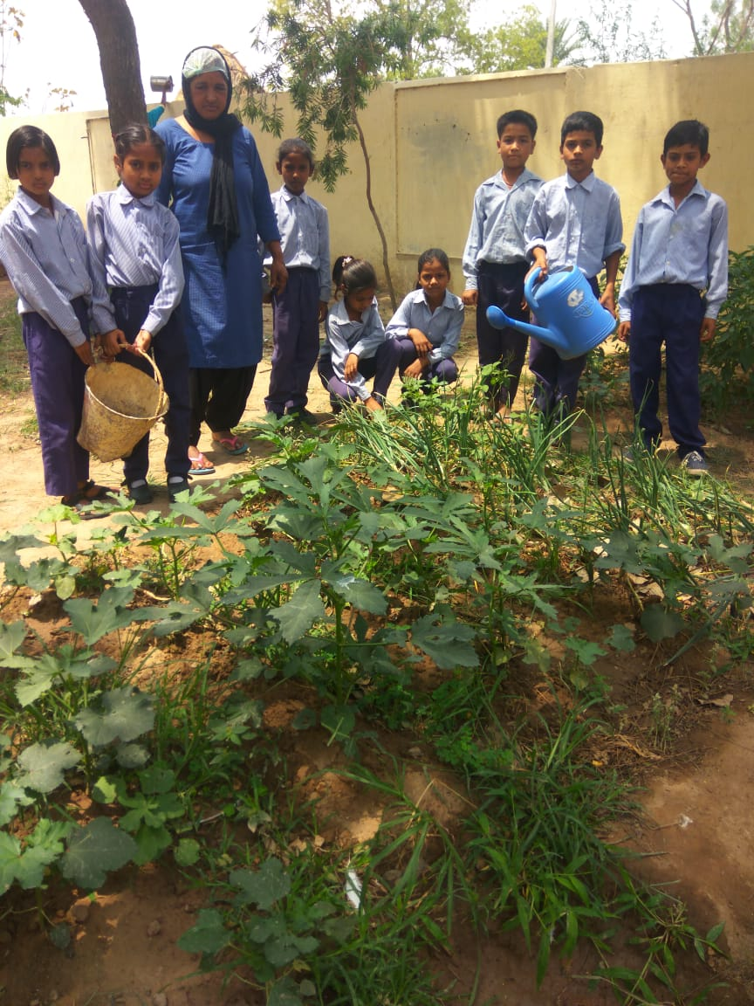
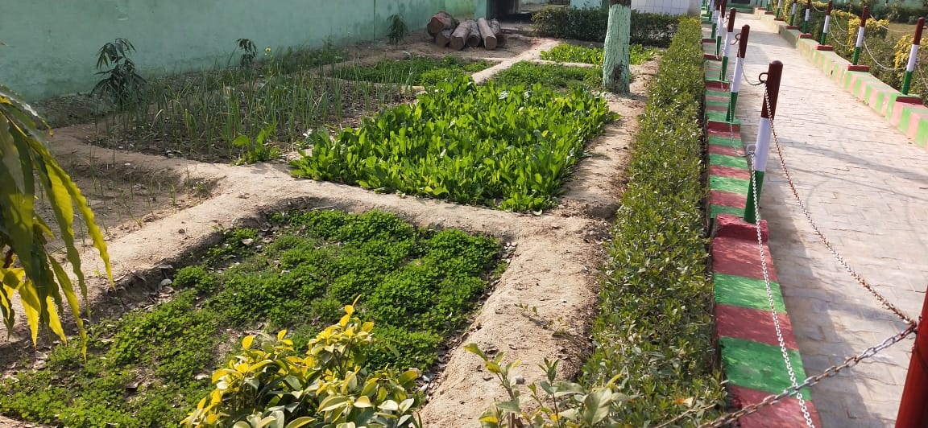
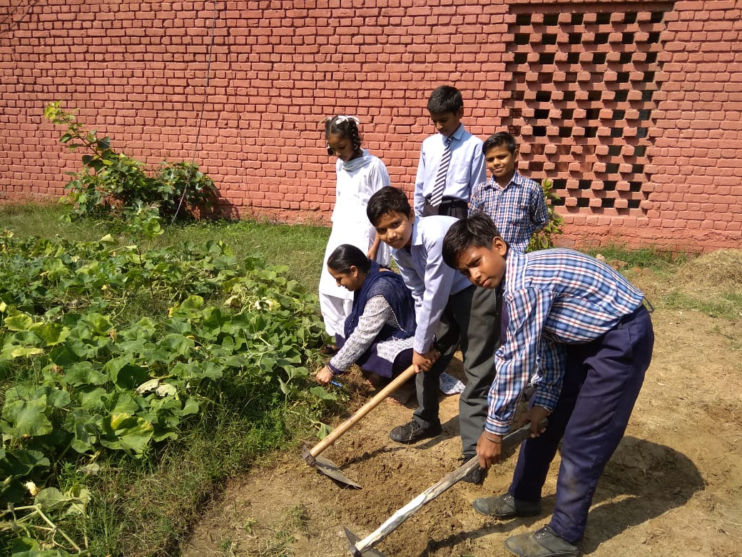
Kitchen Gardens

Slide 27
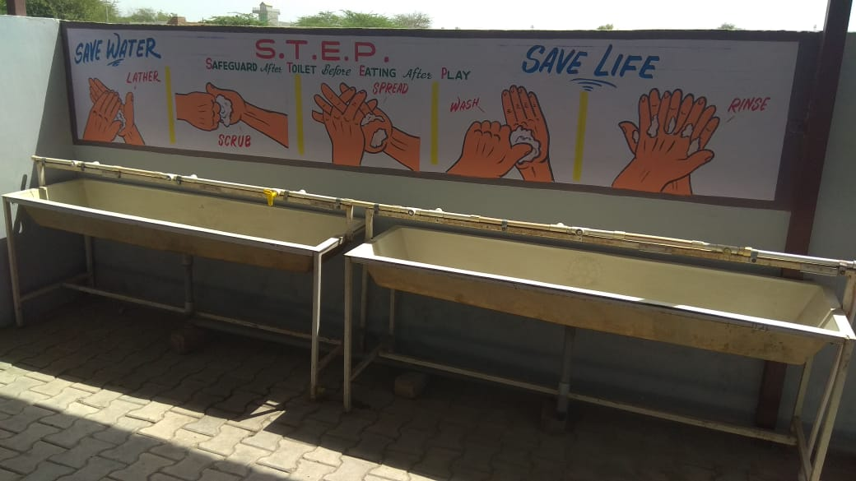
Hand wash before and after Mid Day Meal

Slide 28
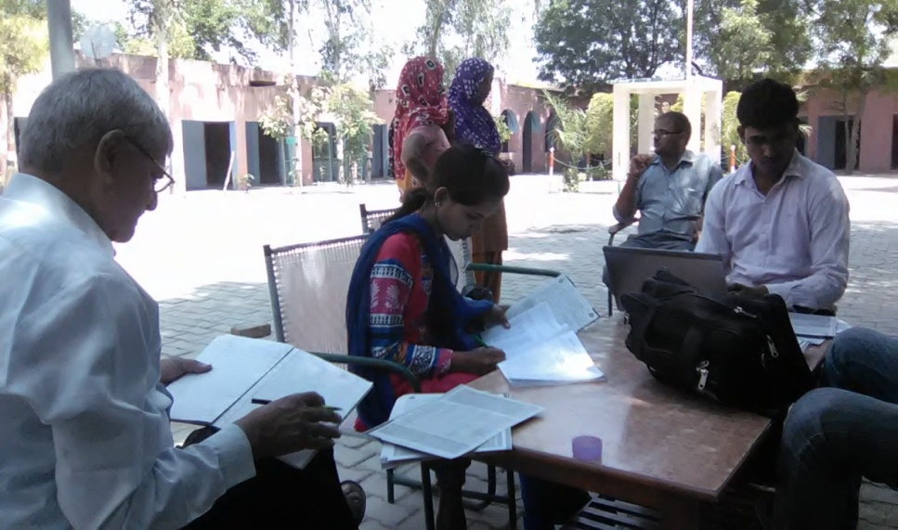
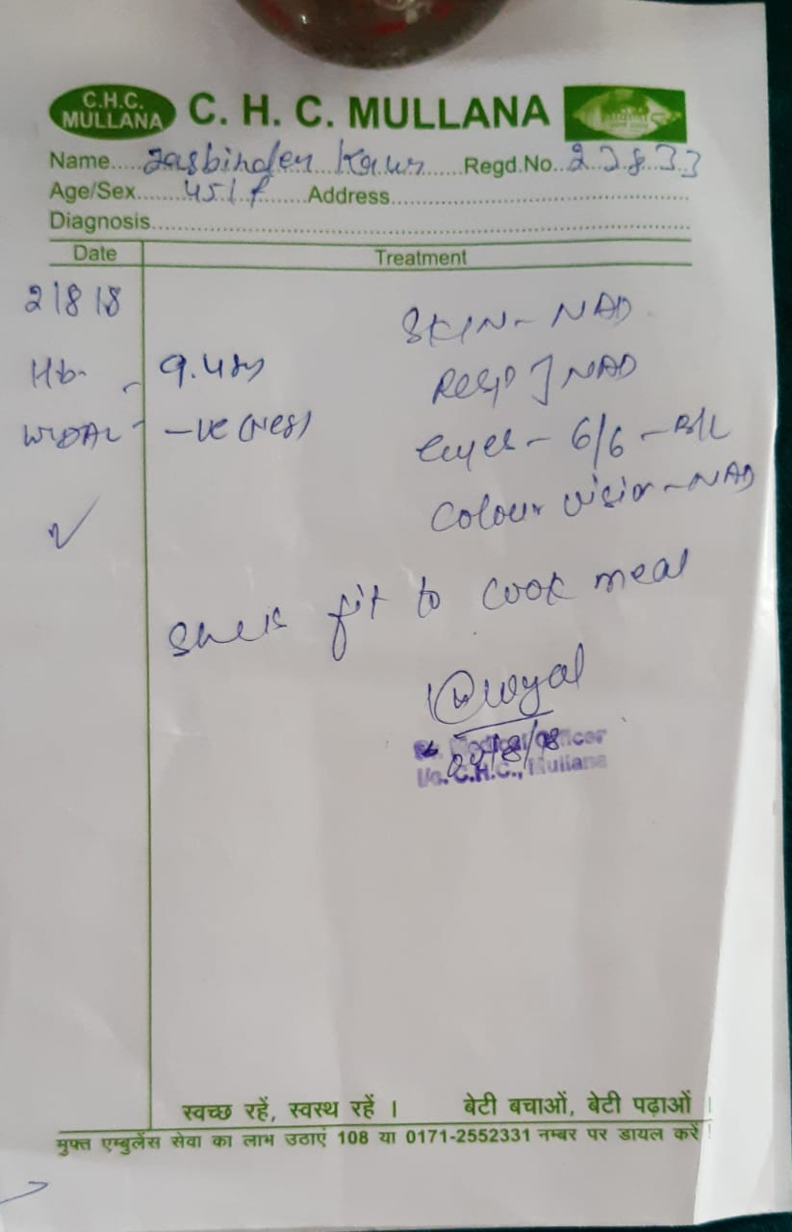
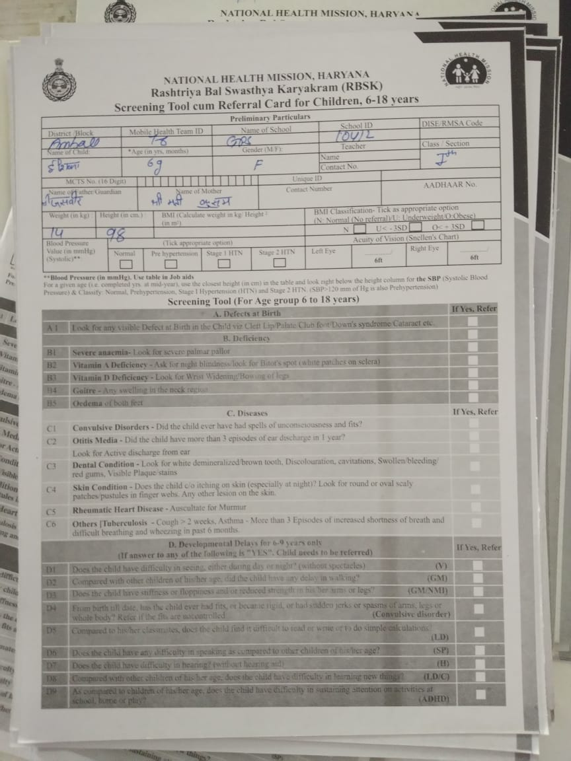
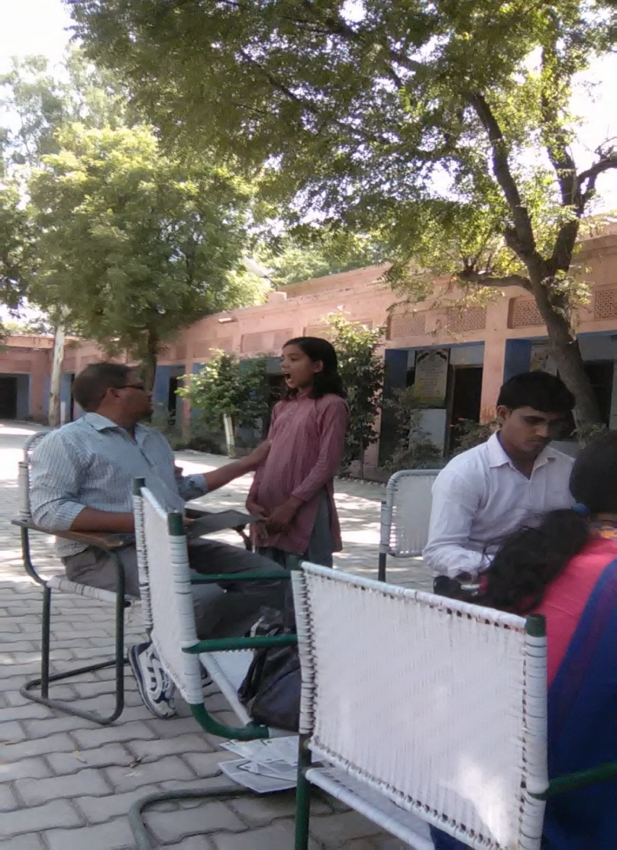
Health Check-up of Children.

Slide 29
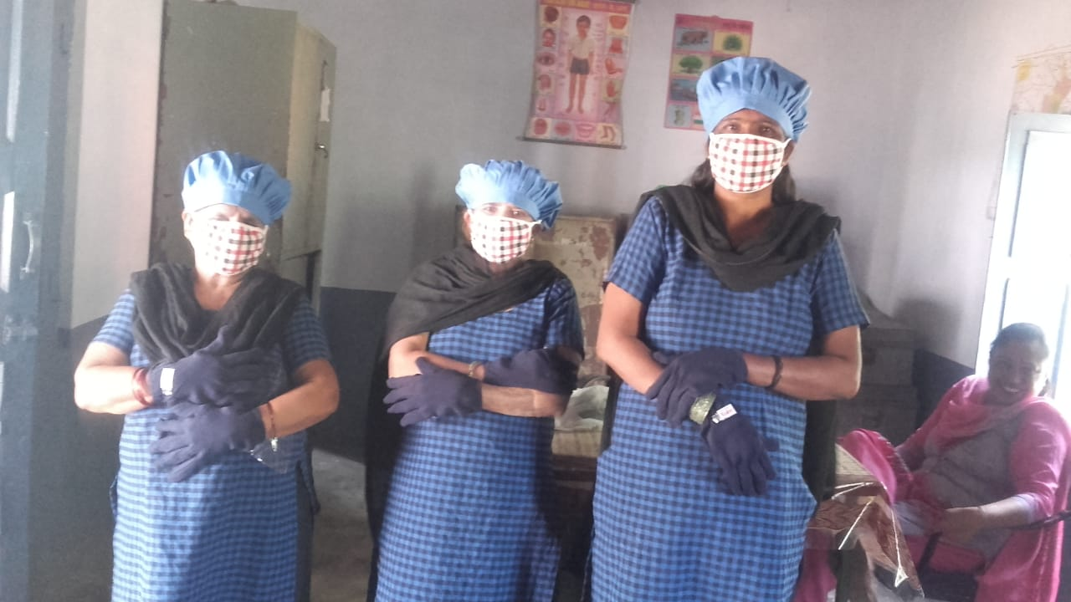
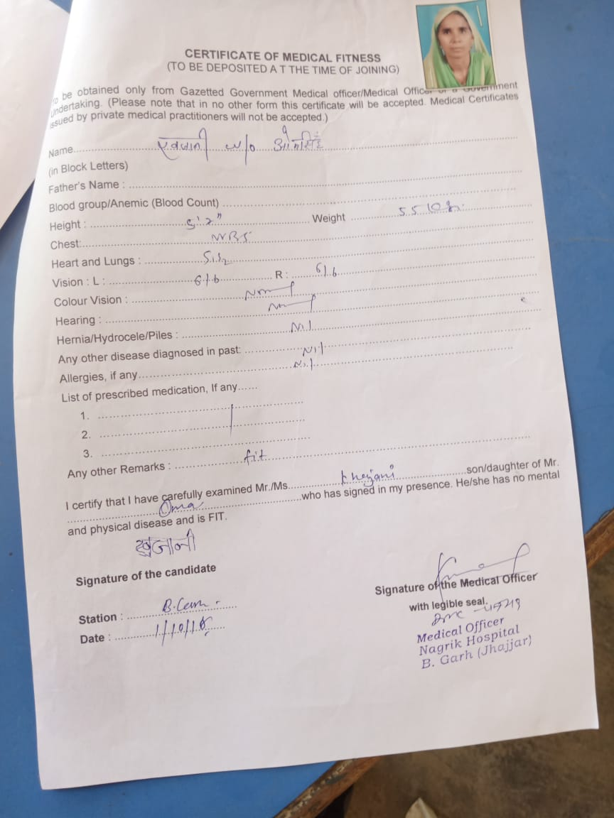
Health Check-up of Cooks and Cooks Uniform

Slide 30
School Health Programme
No of schools covered | 14397
No of children covered | 1448024
Iron and Folic acid supplement | 1315692
De-worming tablet | 1448024
Distribution of spectacles | 5602
In addition to this, during Mid Day Meal week health check up of children was done with the help of NHM.

Slide 31
Best Practices
Tithi Bhojan:-Every 3rd Tuesday of the month is celebrated as girl student’s birthday jointly as “Beti ka Janamdin”- School Mai Abhinandan . All the girls whose birthdays fall in the given month are congratulated and given a special treatment.
It also aimed that encouraging the community participation as parents are also invited to those celebrations and are given a window of free participation in Mid Day Meal and other activities of the schools.
In Haryana State Honorarium to cooks is Rs. 3500/-per month in which Centre Share is Rs.600/- and State Share is Rs.2900/- per month against the mandatory State share of Rs. 400/- per month from 1st June 2018.
Medical examination of CCHs done once in a year.
Kitchen gardens have been established in 2554 schools in Haryana State .
Provision of steel thalis and spoons for children for eating MDM.
Construction of toilets for physically challenged children in Mewat district.
Availability of good quality aluminium storage bins for storing food grains.

Slide 32
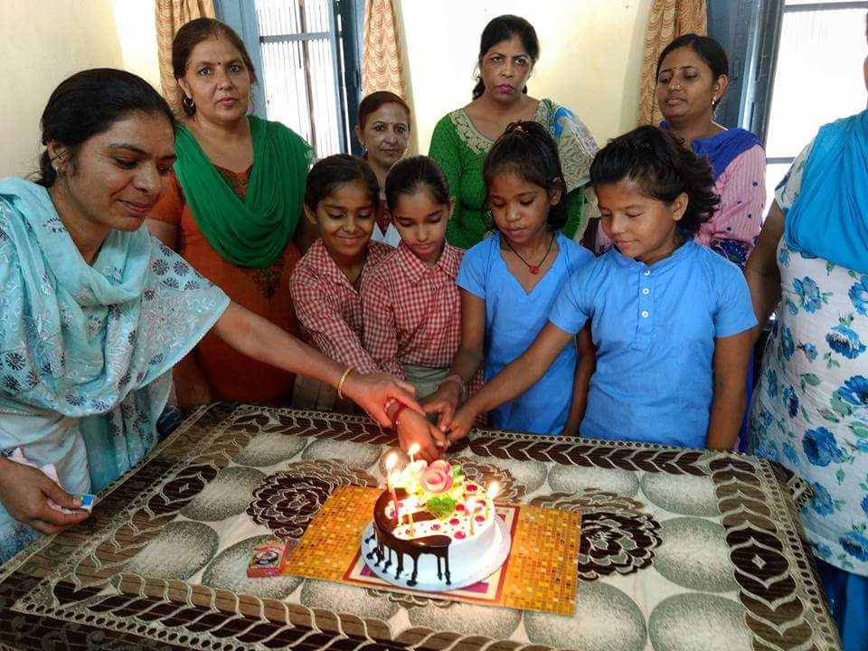
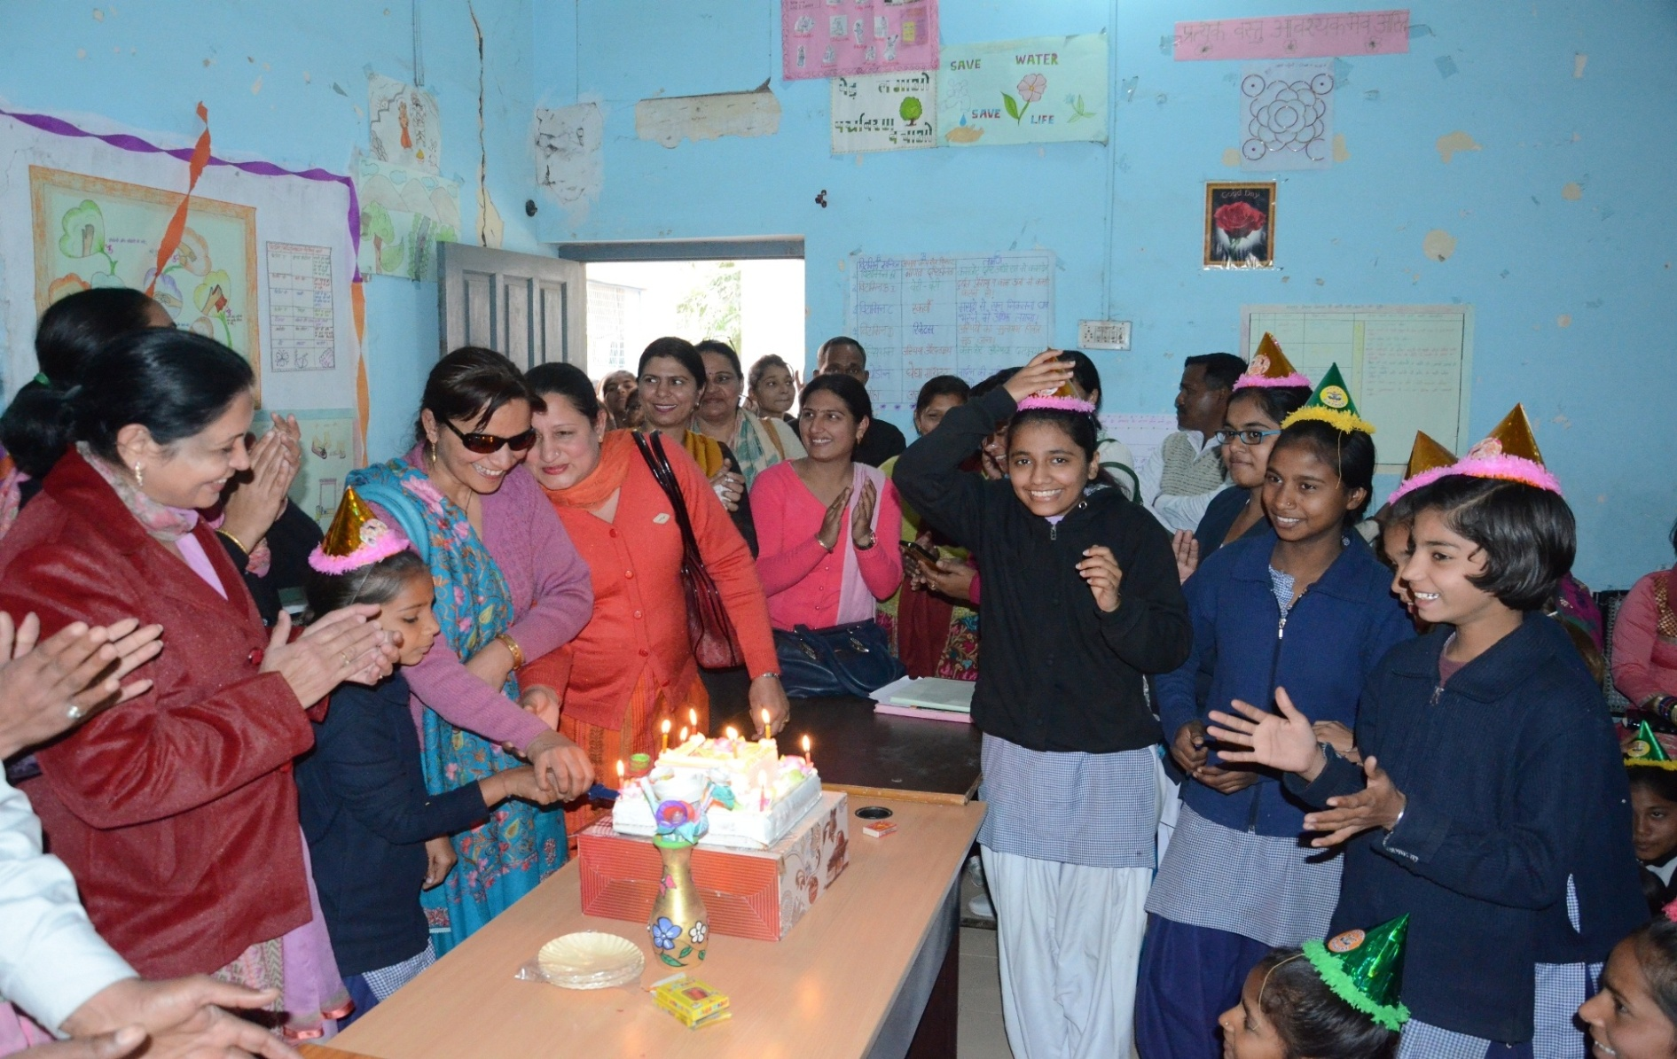
Celebration of “Beti ka Janamdin- School mai Abhinanadan”

Slide 33
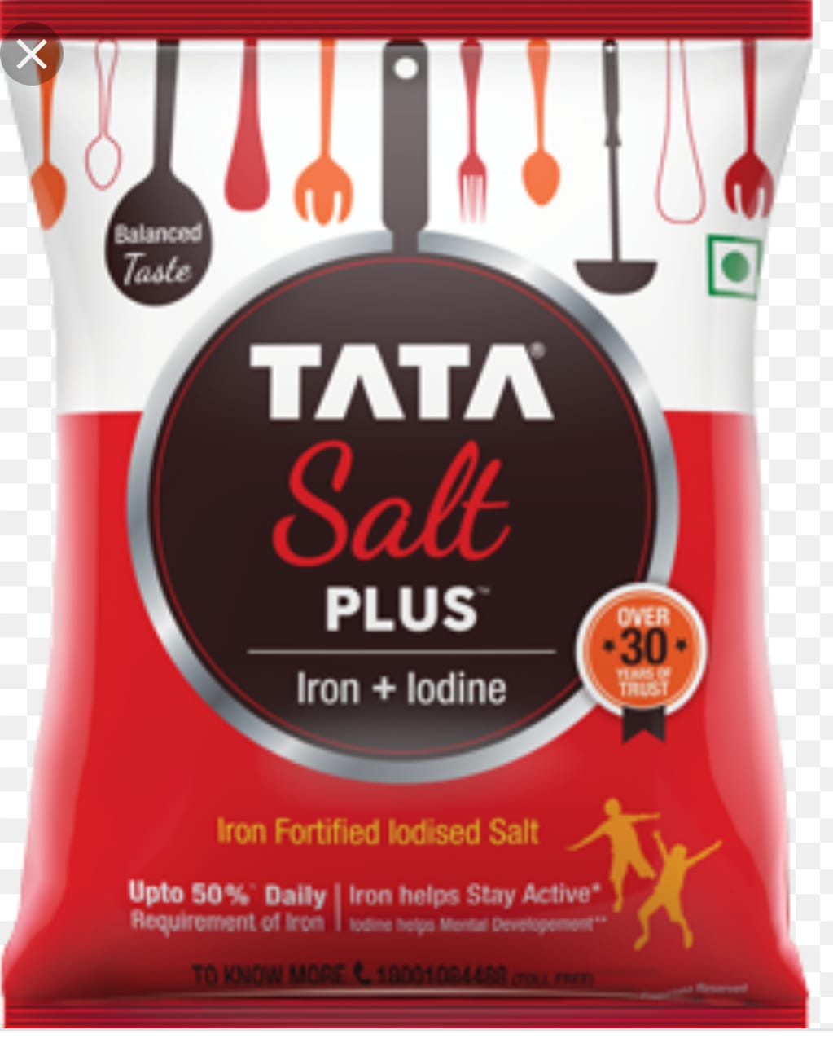
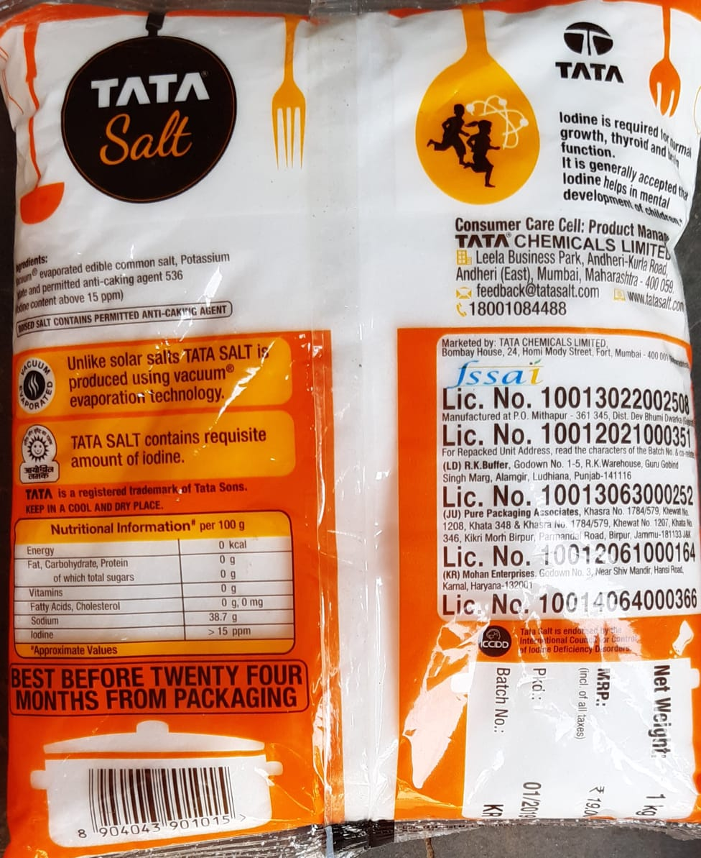
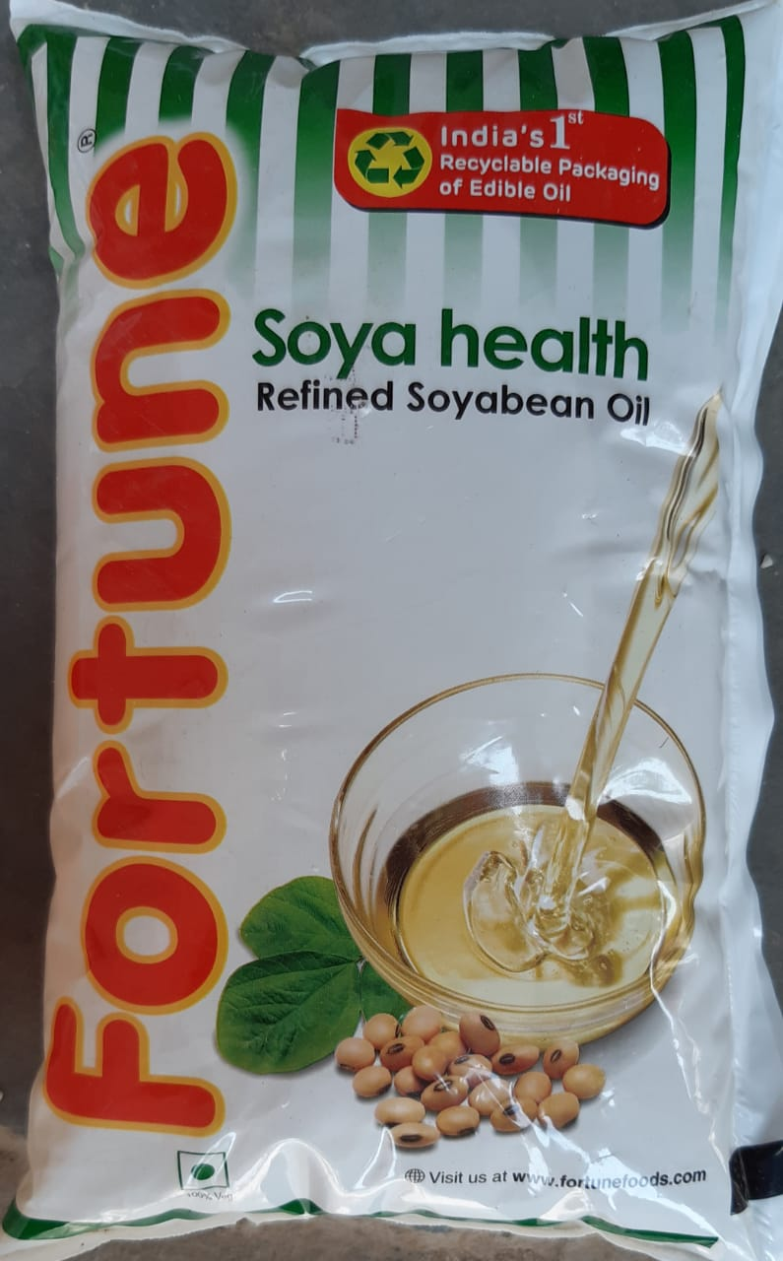
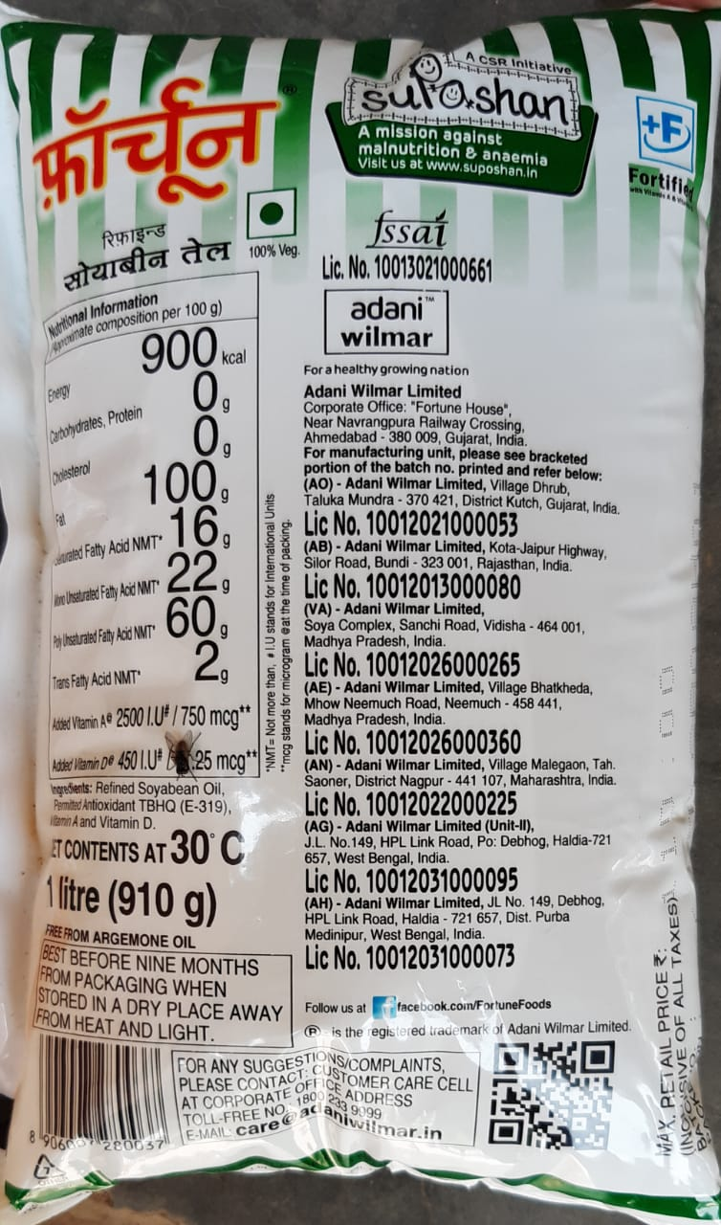
Fortified Oil and Salt

Slide 34
SECTION – V
REVIEW OF ASSURANCE GIVEN IN PAB 2019-20

Slide 35
ACTION TAKEN ON PAB ASSURANCE
Sr.No. | PAB Advice | Office Remarks
1 | To ensure e-transfer of funds to all the remaining cook cum helpers and payment of honorarium to cooks into their bank accounts | In this regard, it is stated that all the cooks are being paid their honorarium through e-transfer/account payee cheques.
2 | To complete the remaining kitchen cum stores . | The State Project Director was requested vide letter No. 1/36-2008 MDM (2) dated 25.09.2019 to ensure completion of all Kitchen-cum- Stores up to 31.03.2020. Constructed 10593 In progress 372 Not started 518
3 | To do the health checkup of all the enrolled children twice a year | NRHM has already been requested to do the health checkup of all the enrolled children at least once in a year. In addition to this, Mid Day Meal Week was also celebrated from 25th to 29th November, 2019. During this week medical checkup of all students & cooks has been done by NHM.

Slide 36
Continued…
Sr.No. | PAB Advice | Office Remarks
4 | To look into the issue of delay in release of funds from State to District/Block/School Level | During the meeting of State Level Steering cum Monitoring Committee held on 19.04.2019, Special Secretary to Govt. of Haryana Finance Department assured that the funds during the Finance year 2019-20 will be released in time.
5 | Awareness generation activities | The General Awareness activities have been conducted by the Department. Advertisements were given in the leading News papers like the Tribune, Hindustan, Times of India, Indian Express, Dainik Bhasker, Dainik Jagran, Amar Ujala, and Punjab kesari for awareness of activities. The Advertisement was given on 91.1 FM and 93.5 Red FM for radio jingles on mid day meal. One day workshop on Food Fortification, safety and Nutrition was also organized on 28.01.2020 for awareness generation activities. The awareness generation activities were also shared by means of pamphlets, posters, You tube link etc. A document of nutritional and related deficiencies has also been prepared

Slide 37
Isckon Districts:-
Sr.no | Name Of Districts | No. Of Schools | Childrens
1 | Faridabad | 410 | 72458
2 | Gurugram | 598 | 85272
3 | Kurukshetra (except Babain & Shahbad) | 544 | 37626
4 | Palwal( Except Hathin) | 427 | 55738
 | Total | 1979 | 251094

Slide 38
Best practices IN 2020-21
It is announced by the Hon’ble CM Haryana that Milk would be provided six days in a week in the year 2020-21 to the students of Primary and Upper Primary Govt. Schools
It is also announced by the Hon’ble CM Haryana that Besan Pinni will be given to the students of Primary and Upper Primary Govt. Schools once in a week .

Slide 39
SECTION – VIII
PROPOSAL OF FUNDS FOR THE YEAR 2020-21

Slide 40
Children proposed to be covered in 2020-21
Type of School | No. of children
Primary | 827306
Upper Primary | 536561
NCLP | 2238
Total | 1366105

Slide 41
Component wise requirement of Budget for the Year 2020-21
(Rs.In Cr.)
Component | Centre Share | State Share | Total requirement for 2020-21
Cost of Food grains | 10.90 | 0.00 | 10.90
Transportation Cost | 4.80 | 0.00 | 4.80
Cooking Cost | 111.91 | 74.63 | 186.54
Honorarium Cook cum Helper @ Rs.3500/- per month | 17.75 | 85.82 | 103.57
Cooks Uniform | 0 | 1.80 | 1.80
Office Expenses | 0.05 | 0.00 | 0.05
MME | 4.00 | 0 | 4.00
Milk Provision | 0 | 82.84 | 82.84
Replacement of Kitchen Devices | 14.50 | 9.67 | 24.17
Repair of Kitchen cum store | 0.14 | 0.09 | 0.23
Flexi fund @5% for new intervention | 7.93 | 5.28 | 13.21
Total | 171.98 | 260.13 | 432.11

Slide 42
Total requirement of Budget for 2020-21
(Rs. in Cr.)
Center’s Share | State’s Share | Total
171.98 | 260.13 | 432.11

Slide 43
Requirement of Budget for the Year 2020-21(Primary Stage)
(Rs. In Cr.)
Component | Centre Share | State Share | Total requirement for 2020-21
Cost of Food grains | 5.40 | 0.00 | 5.40
Transportation Cost | 1.65 | 0.00 | 1.65
Cooking Cost | 55.27 | 36.85 | 92.12
Honorarium Cook cum Helper @ Rs. 3500 per month i.e. Rs.600/-CS &Rs.2900/- SS | 10.89 | 52.65 | 63.54
Cooks Uniform | 0 | 1.08 | 1.08
Office Expenses | 0.05 | 0.00 | 0.05
MME | 2.00 | 0.00 | 2.00
Milk Provision | 0.00 | 49.19 | 49.19
Replacement of Kitchen Devices | 6.98 | 4.66 | 11.64
Repair of Kitchen cum store | 0.07 | 0.04 | 0.11
Flexi fund @5% for new intervention | 3.96 | 2.64 | 6.60
Total | 86.27 | 147.12 | 233.39

Slide 44
Requirement of Budget for the Year 2020-21 (Upper Primary Stage)
(Rs. in Cr.)
Component | Centre Share | State Share | Total requirement for 2020-21
Cost of Food grains | 5.47 | 0.00 | 5.47
Transportation Cost | 3.14 | 0.00 | 3.14
Cooking Cost | 56.38 | 37.58 | 93.95
Honorarium Cook cum Helper @ Rs. 2500 per month i.e. Rs.600/-CS &Rs.1900/- SS | 6.86 | 33.17 | 40.03
Cooks Uniform | 0.00 | 0.72 | 0.72
MME | 1.99 | 0.00 | 1.99
Milk Provision | 0 | 32.98 | 32.93
Replacement of Kitchen Devices | 7.52 | 5.01 | 12.53
Repair of Kitchen cum store | 0.07 | 0.04 | 0.11
Flexi fund @5% for new intervention | 3.96 | 2.64 | 6.60
Total | 85.39 | 112.09 | 197.47

Slide 45
Requirement of Budget for the Year 2020-21 for (National Child Labour Project Schools(NCLP)
(Rs. in Cr.)
Component | Centre Share | State Share | Total requirement for 2020-21
Cost of Food grains | 0.03 | 0.00 | 0.03
Transportation Cost | 0.01 | 0.00 | 0.01
Cooking Cost | 0.27 | 0.20 | 0.47
MME | 0.0085 | 0.00 | 0.0085
Milk Provision | 0.00 | 0.72 | 0.72
Total | 0.3185 | 0.92 | 1.2385

Slide 46
Proposal for MME 2020-21
Sr.No | Particulars | Amount required (Rs. In Cr.)
1 | School Level Expenses | 1.00
(i) | Form & Stationery
(ii) | Training of cook cum helpers
(iii) | Replacement/repair/maintenance of cooking device, utensils, etc.
(iv) | Soaps for washing hands
 | Sub Total | 1.00
2. | Management, Supervision, Training, Internal Monitoring and External Monitoring
(i) | Hiring charges of manpower at various levels | 1.90
(ii) | Transport & Conveyance | 0.10
(iii) | Office expenditure | 0.56
(iv) | Furniture, hardware and consumables etc. | 0.02
(v) | Capacity building of officials | 0.02
(vi) | Publicity, Preparation of relevant manuals | 0.25
(vii) | External Monitoring & Evaluation | 0.20
 | Sub Total | 3.05

Slide 47
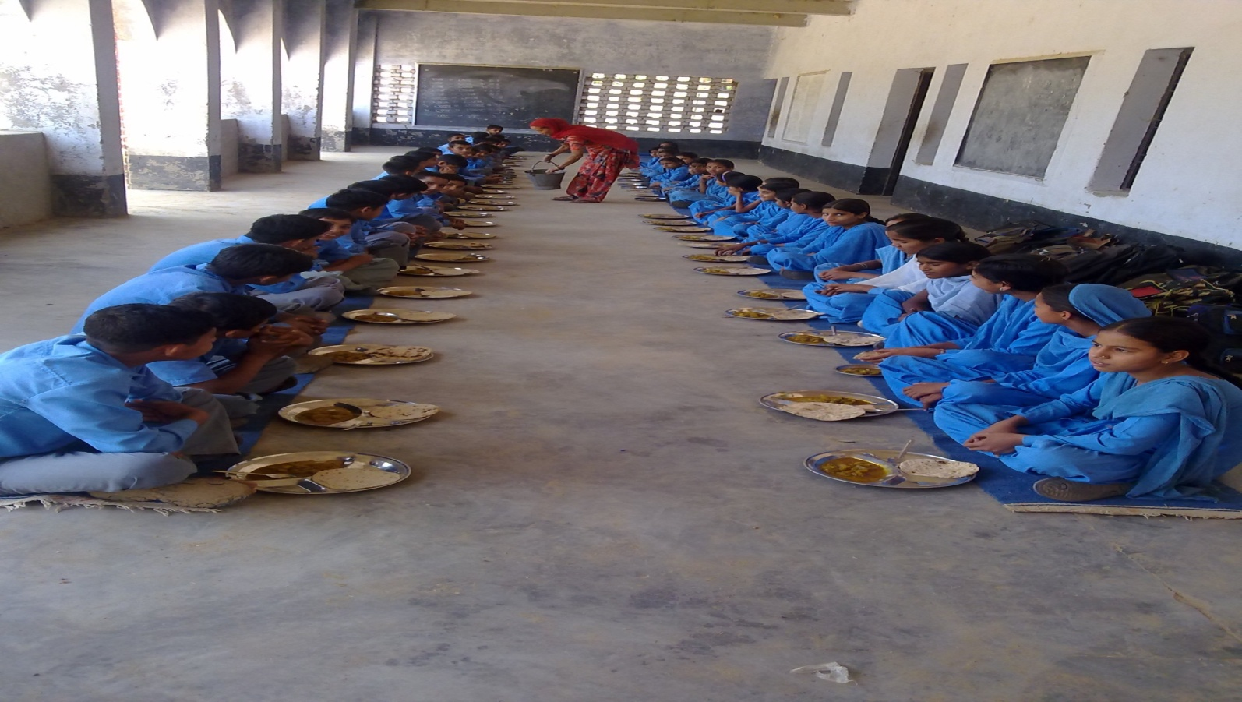
Thank You

